Slide 1

CHAPTER 2
Studying Sexuality: Research Methods and Challenges

Slide 2
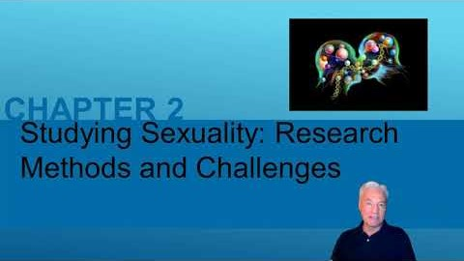

Slide 3
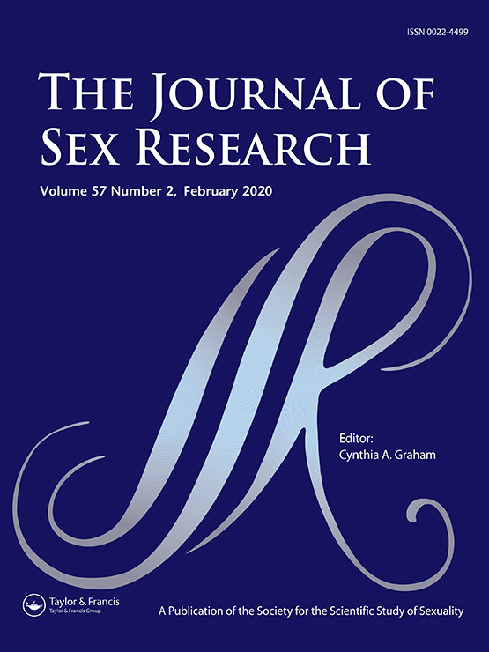
Sexology
Sexology: Formal study of sexual behavior and other aspects of human sexuality
Recently compared to the physical sciences or humanities.
Sexologists: academic researchers and writers who produce scholarly research and writing on sexuality.
Mostly studied within the framework of other disciplines.

Slide 4

Sexology
Is of interest to:
  Researchers from various disciplines such as:
    Psychology, sociology, biology, medicine, religion, law, political science, literature, and history.
Therapists and educators:
  Apply the knowledge generated by sexologists and sexuality researchers.
Media sexperts and journalists:
  Individuals with a general clinical or medical background or no special training at all.
Professional organizations.

Slide 5
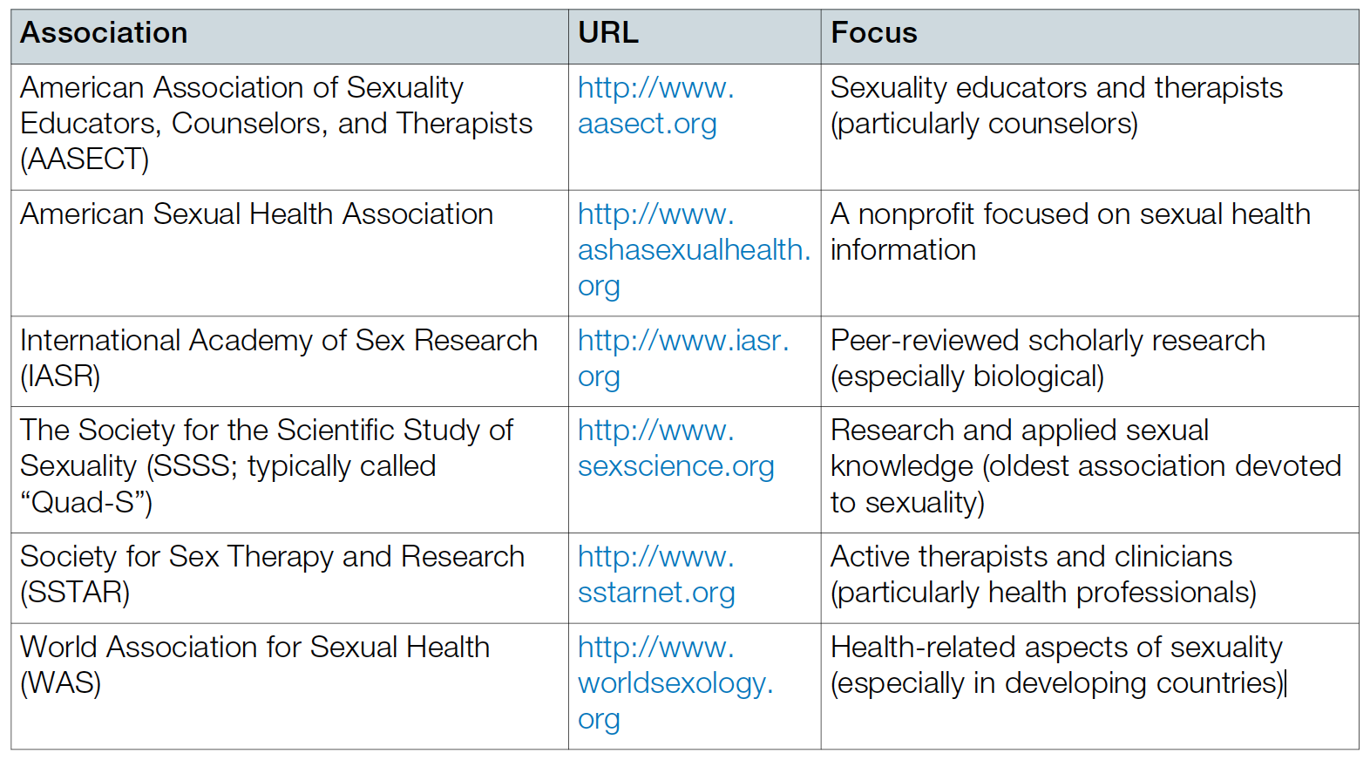
Organizations Focused on Sexuality

Slide 6

Play Video

Slide 7
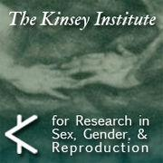
Sexology
Different academic fields and training of sexuality researchers affects the type of:
    Questions asked.
    Research methods used.
    Results obtained.
    Conclusions drawn.
  Contributes to enduring disagreements.

Slide 8
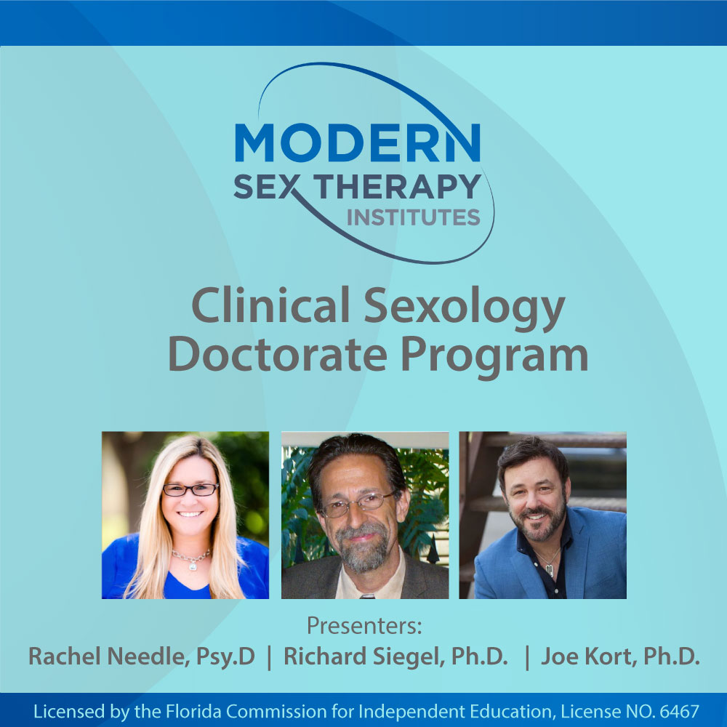
Why Study Sexology
Affects the individual:
  Wellness and happiness.
  Psychological and emotional satisfaction in life relationships.
Adequate knowledge will help in controlling public costs involved with teenage pregnancy and STIs.

Slide 9

Evolutionary and Biological Perspectives
Studied by biologists and a subset of psychologists.
Evolutionary perspective: focuses on similarities and differences across species, including the:
  Biological origins of sexuality and differences between the sexes.
Biological perspective:
  Includes considerations of evolution.
  Focuses on the specific biological mechanisms underlying sexuality or sex differences.

Slide 10
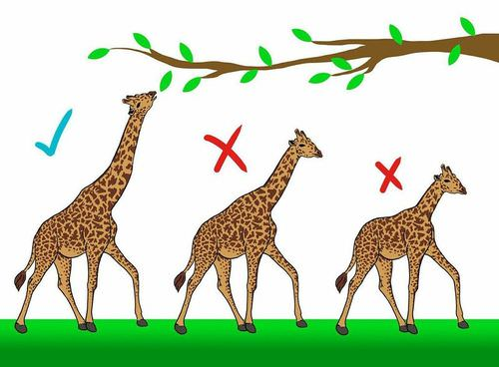
Natural and Sexual Selection
Mechanisms of change in life.
Places different adaptive challenges for females and males in many species and emphasizes continuity across time and species.

Slide 11
Natural Selection
Individuals in a population vary in traits and adaptations.
Those possessing traits that are better fitted to the environment are more likely to survive and reproduce.
Those who do not fit the environment well or do not adapt to a changing environment are more likely to die off.
Leads to extinction in some and accumulation of changes in others across the generations.

Slide 12
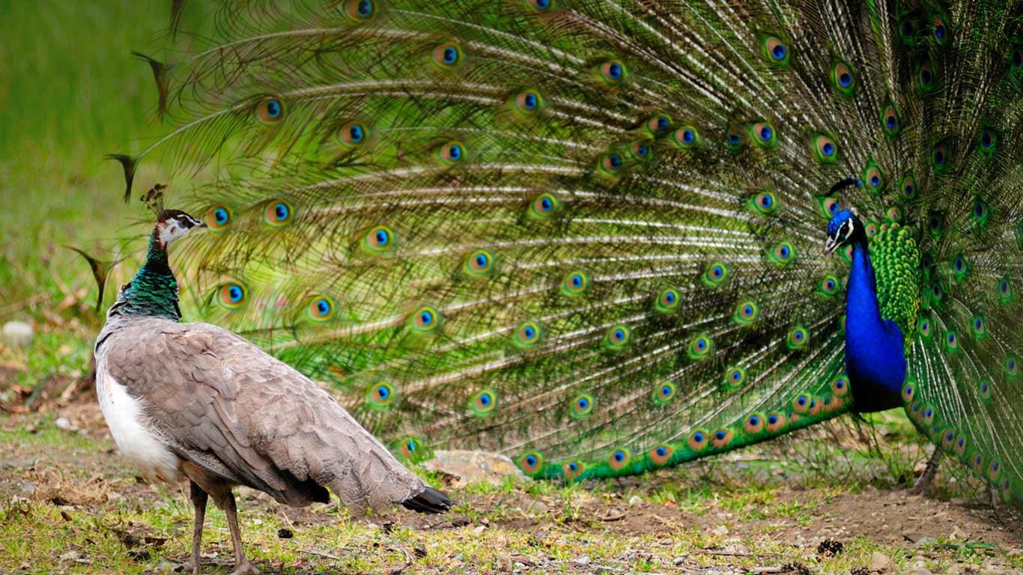
Sexual Selection
Traits and adaptations in one sex that, through competition or a preference lead to:
  Greater likelihood of reproduction, with those traits thus becoming more prevalent across the generations.

Slide 13
Research Focus
  Elewa, 2008:
    Both Darwin and modern evidence suggest that:
      Evolution proceeds at random, building on earlier forms but frequently resulting in individual species or even entire groups of species dying off.
    Fossil record provides evidence of at least five mass extinctions.

Slide 14
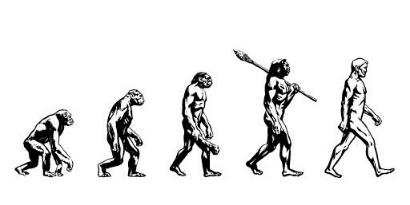
Natural and Sexual Selections
Usefulness of evolution:
  Provides a unifying framework in studying sexuality.
  Essential to understand the origins and function of sexual behavior in any particular species.
Benefits of sexual reproduction:
  Greater resistance to disease in offspring.
  Decreased likelihood of deleterious mutations:
    Having harmful consequences.
    Being accumulated across generations.

Slide 15

Cultural Perspective
Draws on examples of multiple cultures and historical eras and multiple dimensions of cultural uniqueness.
Helps identify:
  How culture affects identity.
  Patterns of cognition and social processes that may differ between cultures.
  Research indicates that aspects of human nature thought to be universal or innate can be a result of learning.
  On sexuality:
    Considers religious beliefs and practices:
      Treating males and females differently.
      Placing numerous restrictions on sexual expression.

Slide 16

Social Learning Perspective
Considers the ways in which social environment in combination with innate tendencies shapes behavior.
Focuses on the interaction of nature and nurture.
Social learning orientation:
  Focuses on factors in a person’s family or social environment, social cognition, and individual differences.

Slide 17
Social constructionism perspective
All observable aspects of sexuality and sexual difference in humans result from:
  The social environment and the meanings that we give to concepts.
Does not consider any role for biology in creating sex differences.
Advocates of constructionism suggest that:
  All concepts of knowledge, including gender and sexual orientation are:
    Themselves social constructions.
    Products of a particular cultural environment and moment in history.
  Ways of classifying sexual orientation and gender identity have differed across cultures and historical eras.

Slide 18
Sexual Jealousy and Premature Ejaculation
Biopsychosocial Model:
  Emphasizes that understanding, treating, and preventing disease, and improving health, requires:
    Understanding of multiple levels of causation that interact.
  Serves as a useful paradigm when exploring facets of human behavior and health, including sexuality.
Multiple theoretical perspectives are useful in understanding commonly encountered sexual phenomena:
  Sexual jealousy
  Premature ejaculation

Slide 19
Research Methods in Sexology
Scientific method: building theories to explain observations of the natural world leading to testable hypotheses.
Principle of falsifiability: constructing experiment to test a null hypothesis.
Bayes Theorem:
  Instead of accepting or rejecting a hypothesis, one should directly test one’s confidence in a theory:
    Each experiment lowers or increases the support.
  Amount of change in confidence should include:
    Evidence of the study in question.
    Prior probability (i.e., other existing evidence for a theory).

Slide 20
Experimental Designs
Independent variable: a factor that is manipulated to potentially produce some effect.
Dependent variable: a factor or effect that is measured in an experiment to see if a result has occurred.
Operationalization: specific ways in which the independent and dependent variables are defined.
Require:
  Random assignment: placing participants in groups at random so that choice cannot influence the outcome.
  Generalizable sample: extent to which a sample of participants represents a larger population.

Slide 21
Correlations and Associations
Confounds: factors that may be causing a difference other than what one is measuring:
  May be reduced by random assignment and experimental design but cannot always be eliminated
Correlation:
  Measure of the strength of the relationship between two already existing factors that each have a range of values
  Can range from 0 to +1 or −1

Slide 22
Other Techniques
Case studies: experiences of a small number of individuals (sometimes just one) described in detail.
Surveys:
  Involve asking people questions.
  Test for correlations and associations.
  May lead to non-representative results:
    Difficult and expensive to obtain a truly random sample that is representative of a large population.
    People are uncomfortable about sexual questions, or may not respond honestly to questions about sex.
    Lack of clearly agreed-upon measures for some constructs.

Slide 23
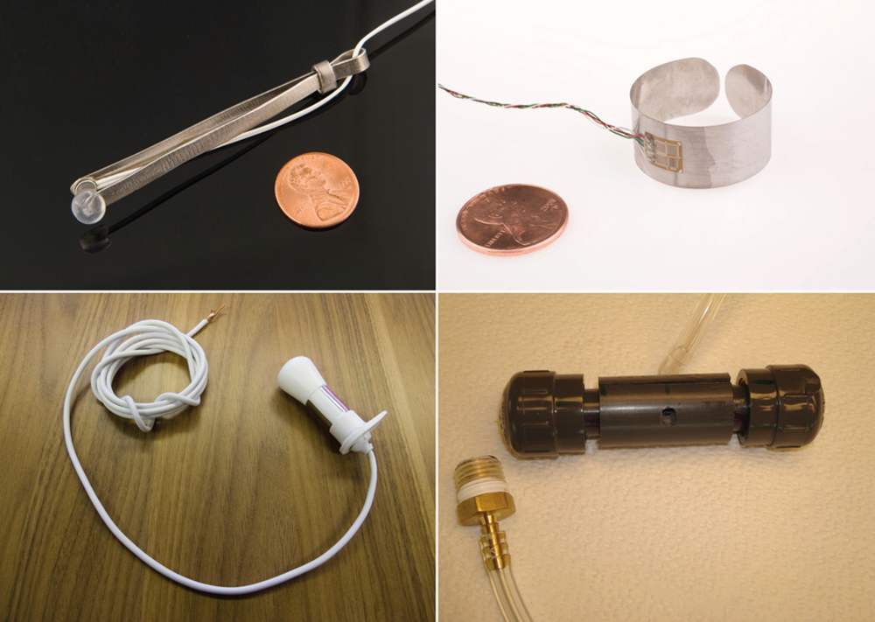
Instruments of Research
Functional magnetic resonance imaging (fMRI):
  Identifies levels of activation in the brain, with a spatial resolution and a temporal resolution of less than a second
Dissection of brain.
Penile plethysmograph:
  Most often an elastic band-like device that is filled with a substance that changes electrical resistance as it stretches.
Vaginal photoplethysmography:
  Records changes in vaginal blood flow by changes in the absorption of light in vaginal tissues
Surveys to ask people about their attitudes or behavior:
  Measurement scale: collection of questions designed to assess an underlying construct that is a theoretical idea

Slide 24
Institutional Review Board (IRB)
Institutional Review Board (IRB): Independent review panel to which researchers are required to submit proposed human or animal research
Requires researchers to:
  Get informed consent (agreement to participate in a study) from participants.
  Give notice about general study purpose to participants.
  Describe steps to be taken to protect the confidentiality and anonymity of data.

Slide 25
Research Focus
Yeater, Miller, Rinehart, & Nason, 2012:
  Evidence suggests that participants actually report very low levels of trauma on being asked about sexuality:
    Even when asking people with a history of earlier victimization about child sexual abuse and rape.
  IRBs need not be concerned that sexuality surveys typically meet the minimal harm criteria.

Slide 26
Ethical Issues in Sexuality Research
To survey children and adolescents on sexual behavior requires:
  Informed consent to participate must come from the parent as well as the child.
Ethical dilemma for confidentiality:
  Ethical obligation to maintain confidentiality in cases like child abuse, which should otherwise be reported.
  Conclusions from sexuality research can become highly politicized.

Slide 27
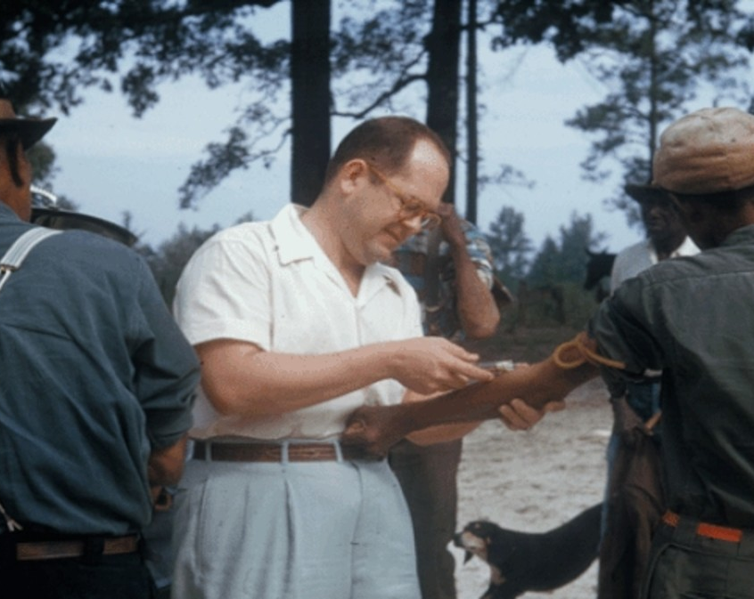
Criminal Violations in Sexuality Research
Medical experiments on reproduction conducted at Nazi camp in Auschwitz.
Forced sterilization of people with intellectual impairments.
Involvement of the US government in Tuskegee syphilis experiments.

